Slide 1
FSA ID Creation Process for Contributors Without an SSN

Slide 2
FSA ID’s for Contributors Without an SSN
Starting with the 2024-25 FAFSA, everyone contributing (students and parents) to an application will need to create an FSA ID. This includes those without an SSN. This slide deck will walk you through the new process. Contributors without an SSN can start creating an FSA ID starting December 2023.

Slide 3
The Steps To Applying for Financial Aid
Determine Which Application You Should Use
Create an Account
Complete your FAFSA or WASFA
Gather Your Information
You Are Here

Slide 4
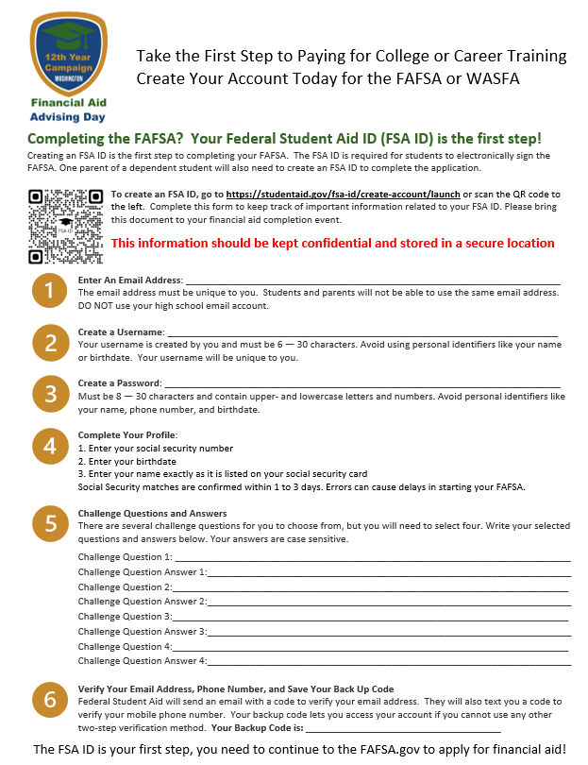
Start with Your FSA ID Worksheet
This worksheet will walk you through creating your FSA ID
This information should be kept confidential
The best place to store this is with your 2022 income tax information.

Slide 5
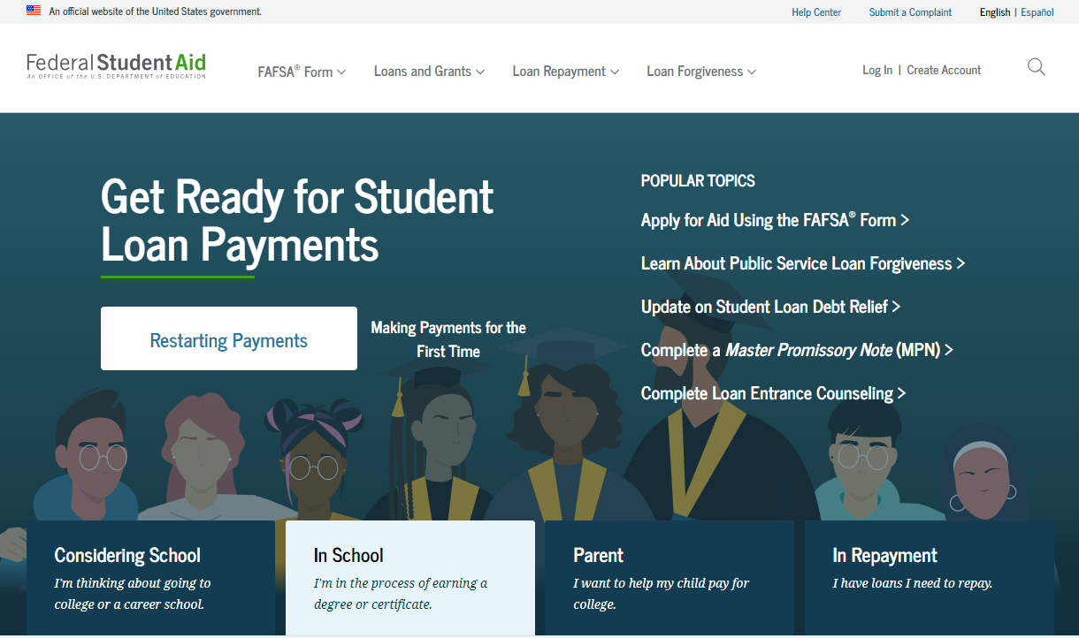
Go StudentAid.gov
The site is available in English or Spanish
Click Create Account to get started with your FSA ID

Slide 6
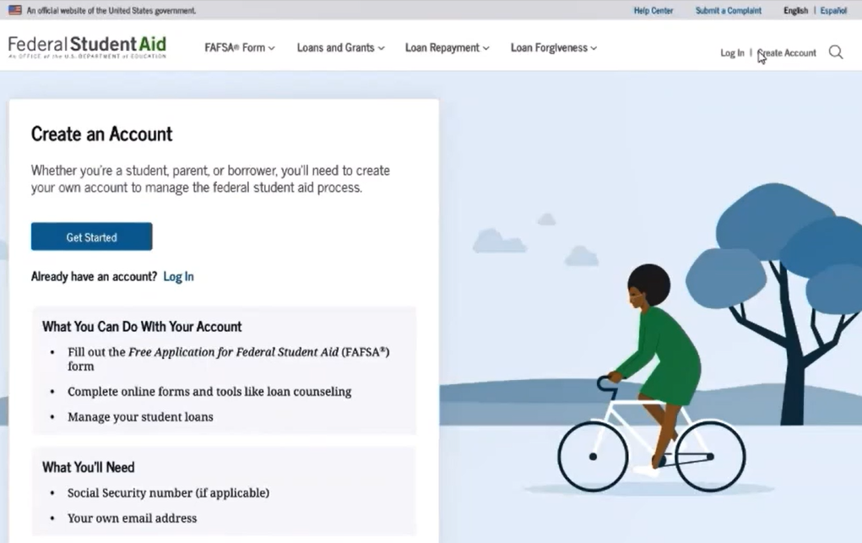
Start on the Create an Account Page
Notes:
This slide shows the language update where an SSN is only if applicable

Slide 7
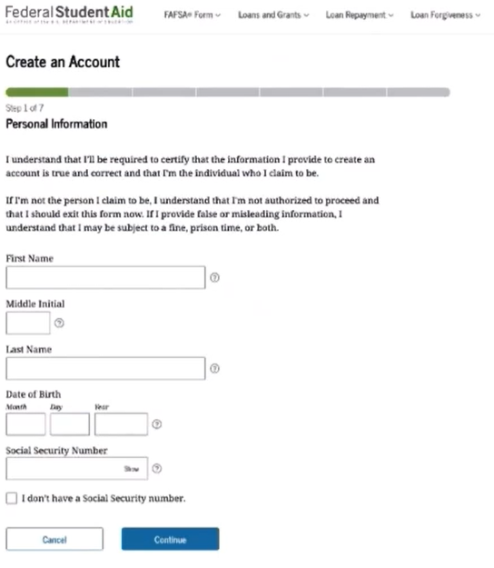
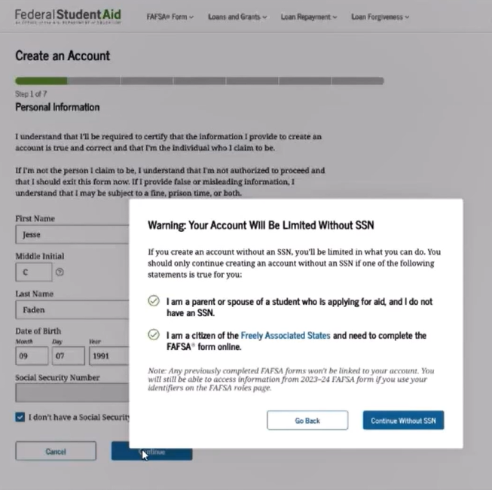
Step #1 – FSA ID - Enter Personal Information
Notes:
This language is meant to discourage those with an SSN from selecting they do not have one. There is a warning once the person selects continue that lets them know there are limitations to accounts for those without an SSN.

Slide 8
Step #2 – Enter Account Information
Email address must be unique to the person creating the FSA ID.
The username cannot include the email address

Slide 9
Step #3 - Contact Information
Mailing address is one of the elements needed to verify the identity of individuals without an SSN and is required
If an address is not provided an error will show at the top of the page and the applicant cannot progress to the next step
International phone numbers cannot be used as a phone number. Phone numbers are not required to create an FSA ID.
FSA recommends that the applicant uses a physical mailing address vs a PO Box.

Slide 10
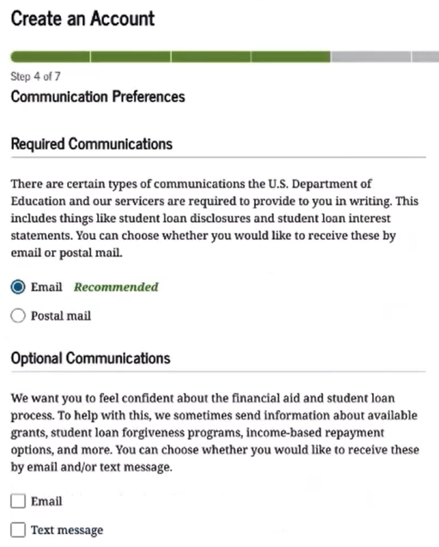
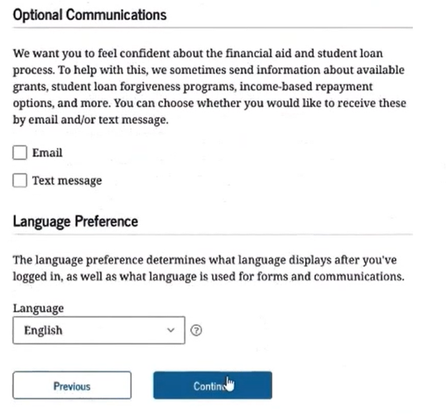
Step #4 – Communication Preferences

Slide 11
Step #5 Challenge Questions

Slide 12
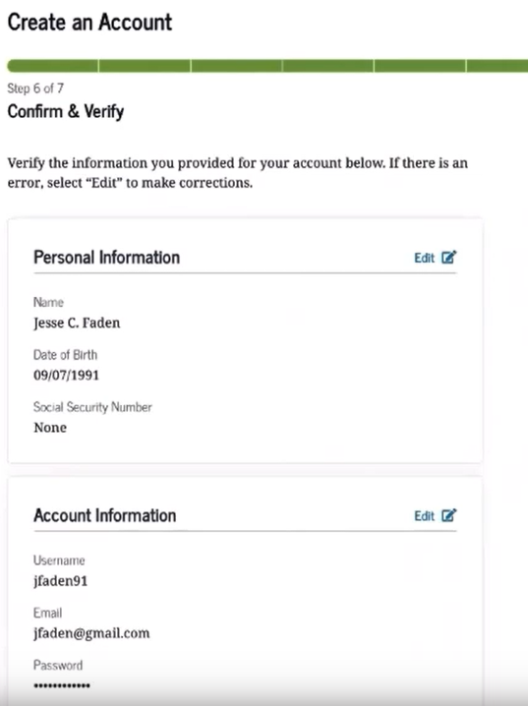
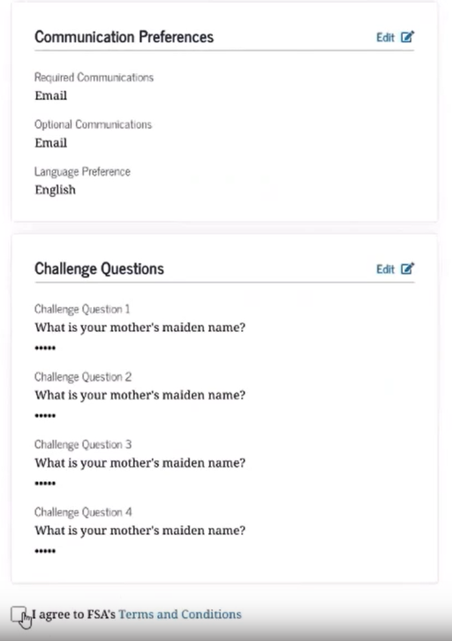
Step #6 Confirm and Verify
This is where you can double check all your information for accuracy and edit if needed.
You can write down the answers to your challenge questions on your FSA ID worksheet.

Slide 13
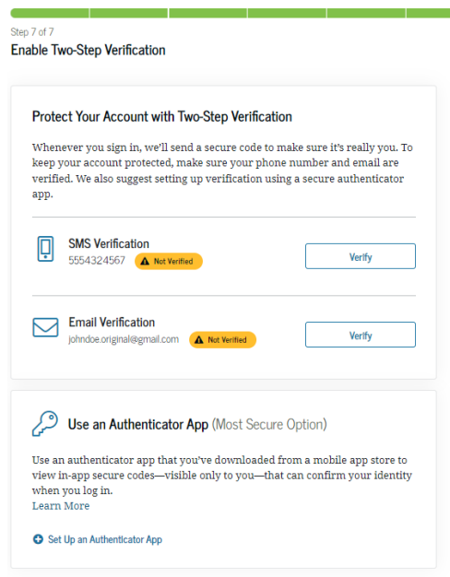
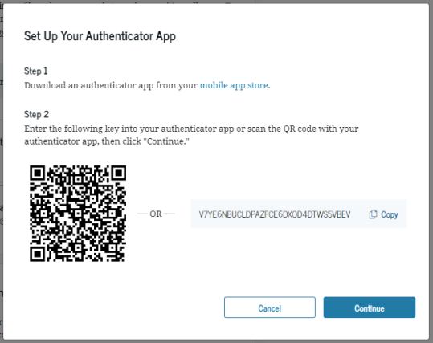
Step #7 Enable Two-Step Verification
Setting up an Authenticator App is an optional but recommended.
You are required to verify your email address.

Slide 14
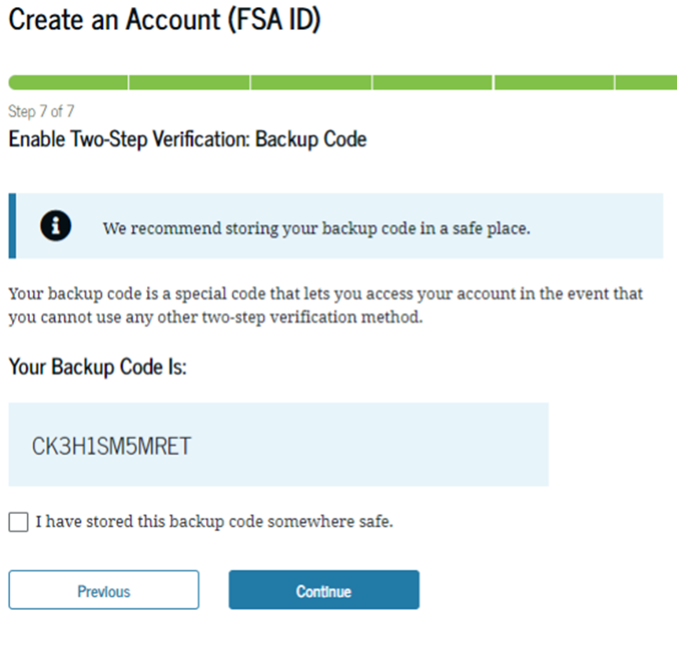
Step #7 Backup Code
Please store your backup code somewhere safe now. If you cannot access your account through two step verification, this is the only way to access your account.
Notes:
If someone loses their backup code, they can create a new backup code in account settings. This only works if they lose it when they have access to their account. If they lose their back up code and lost access to their account, they will have to call the help desk and open an ID Account Recovery Case. They will be required to provide forms of identification to access their account.

Slide 15
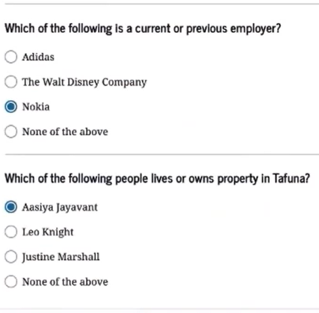
Step #7 – Identity Verification
You only have one opportunity to answer these questions correctly.
These are examples of the questions asked in the knowledge-based identity verification
No credit history is required to generate questions.
This process is generated by a credit bureau, but no credit check is completed.
Notes:
Generated by a credit bureau but no credit check is preformed, and no credit history is required to generate questions.

Slide 16
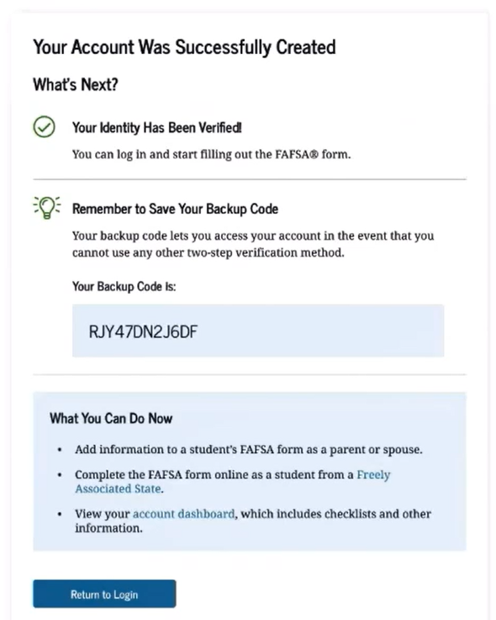
Identity Verification - Verified
If the user’s identity is verified through the knowledge-based questions, they can start using their FSA ID to log in and complete their section of the FAFSA.
Notes:
This slide show what it looks like if you can be verified through the knowledge-based questions.

Slide 17
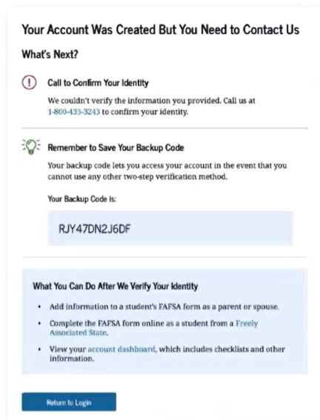
Identity Verification – Not Verified
You cannot go back to try and answer the questions again
Account was created, but cannot be used until the additional verification process is completed
This process requires them to call The Federal Student Aid Information Center (FSAIC)
An email will be sent to let the person know their next steps to complete the FSA ID process.
Notes:
These slides show the process if a person is unable to be verified through the knowledge-based questions.

Slide 18
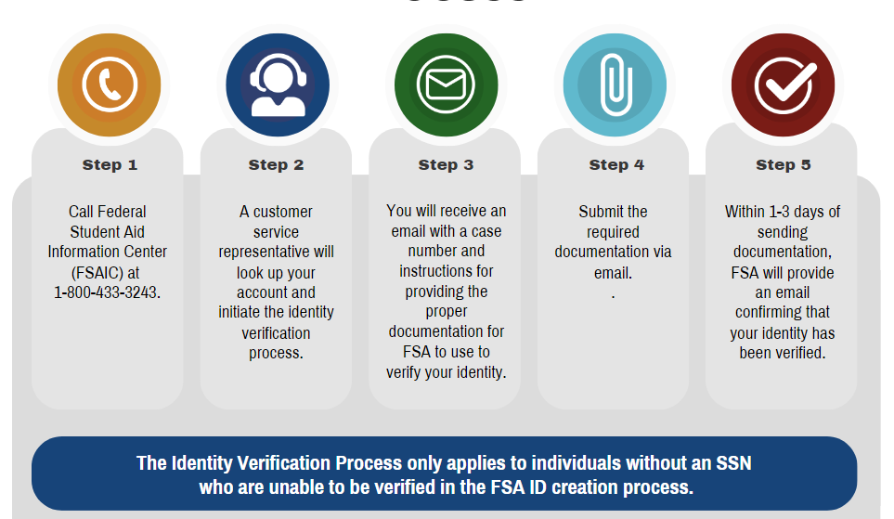
Identity Verification Process

Slide 19
Identity Verification Required Documents
Everyone must provide a completed attestation form and provide required documents. Forms of ID must be unexpired
Proof of Identity
A Utility Bill & ID
One of the following forms of ID
Driver’s License
State or Cite Identification Card
Foreign Passport
Or
The utility bill must have the address that matches their account and their name on the bill.
One of the Following forms of ID will meet this requirement
Municipal identification card
Community ID
Consular identification card
Notes:
A link to the attestation will be provided in the email sent to the student and available at StudentAid.gov

Slide 20
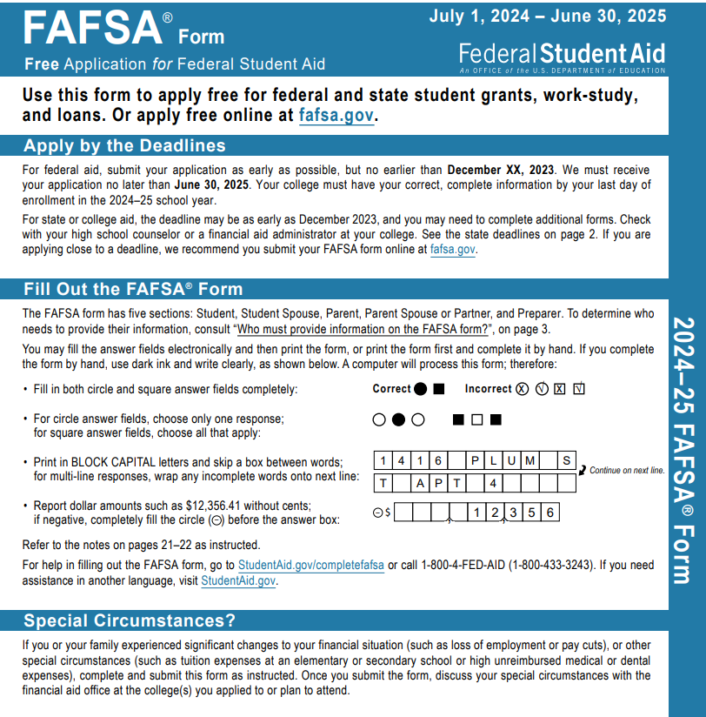
Those Without Required Verification Documents
If a parent cannot provide the documents for the FSA ID identity verification process, they can still complete a paper application with their student.
They may need access to a printer if the document cannot be printed at school or a library.
Will need to be mailed into Federal Student Aid.
Takes longer to process the paper application.
Notes:
Yaslin

Slide 21
Taking the Next Step
Determine Which Application You Should Use
Create an Account
Apply for Financial Aid
Gather Your Information
Next Step

