Slide 1
How To Modify Your Financial Aid (FAFSA/WASFA):
Whatcom Community College

Slide 2
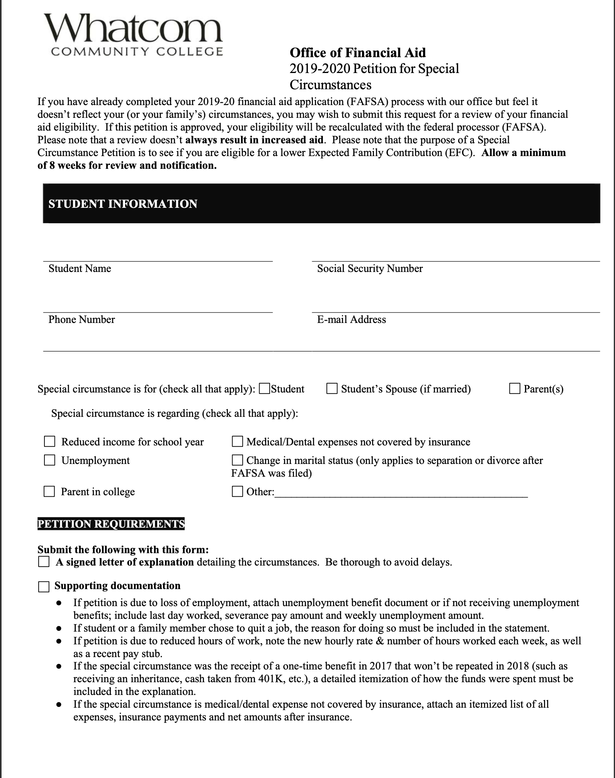
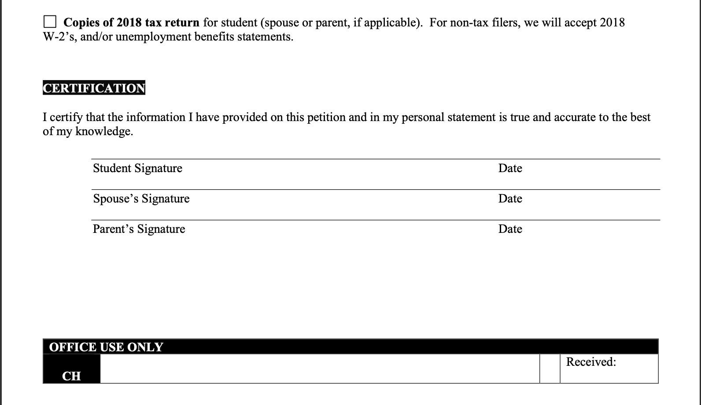
Petition For Special Circumstances:
Whatcom Community College offers student’s the ability to appeal their financial aid award through a form offered online.
Link: https://www.whatcom.edu/get-started/financial-aid/forms
*Video example

Slide 3
Student Information
*As listed on your FAFSA
*Double check

Slide 4
Special Circumstances
Reduced income for school year:
The family is concerned that it will not be able to meet it’s required contribution
Ex.Due to COVID-19
The previous year’s income was affected by a significant one-time event that aren’t typical of the family’s ability to meet its required contribution
Ex. inheritance, cashing in 401k, an unusually high paid bonus for the year
A parent dies, is incarcerated, becomes disabled, or is institutionalized
Social security benefits or child support ceases when the child reaches the age of majority
Medical/Dental expenses not covered by insurances:
There are high unreimbursed medical/dental expenses not covered by the individual’s insurance

Slide 5
Special Circumstances
Other:
A member of the family is seriously ill
The family suffers a natural or financial disaster
Ex. COVID-19, landslide
There are high dependent-care costs related to a special needs individual or elderly grandparent
Unemployment:
A parent loses a job or experiences a salary reduction
A parent’s income varies annually due to the volatility of their job
Ex. Seasonal job: agriculture, construction, warehouse job, etc.

Slide 6
What Does Not Qualify As A Special Circumstance(s):
Although examples of special circumstances aren’t exhausted, there are some cases that are not ground for appeal. Such as:
The student parent(s) refuse to complete the FAFSA or any verification processes
The student demonstrating total self-sufficiency (paying their own bills, living on their own, etc.)
The student’s parents do not claim the student as dependent on taxes
The students parents refuse to help pay for their college education

Slide 7
Petition Requirements
Tips for the letter of explanation:
Include your name, student number (if given), birthday
Don’t include your social security
How circumstances have changed
If you or your parent lost a job
Date of the last time you or a parent had worked
How it has impacted your income or ability to pay for collage
If a family member has fallen ill
Examples:
“Due to losing my job, my income has dropped $4,000 since my last tax return”
“My father, who will be paying for my education, was diagnosed with cancer last month, and will be completing chemotherapy over the next 6 months.”
Website Resource:https://www.collegechoice.net/admissions/the-fafsa-appeal/

